Slide 1
Vaibhav Puranik
Lambda Architecture with Cassandra

Slide 2



About me

Slide 3

Invented In Image advertising in 2008
http://gumgum.com/gallery
Computer Vision
Processing 2.6B image impressions / month
10B events / day
2000 premium publishers
165 employees in 3 continents

Slide 4



Slide 5

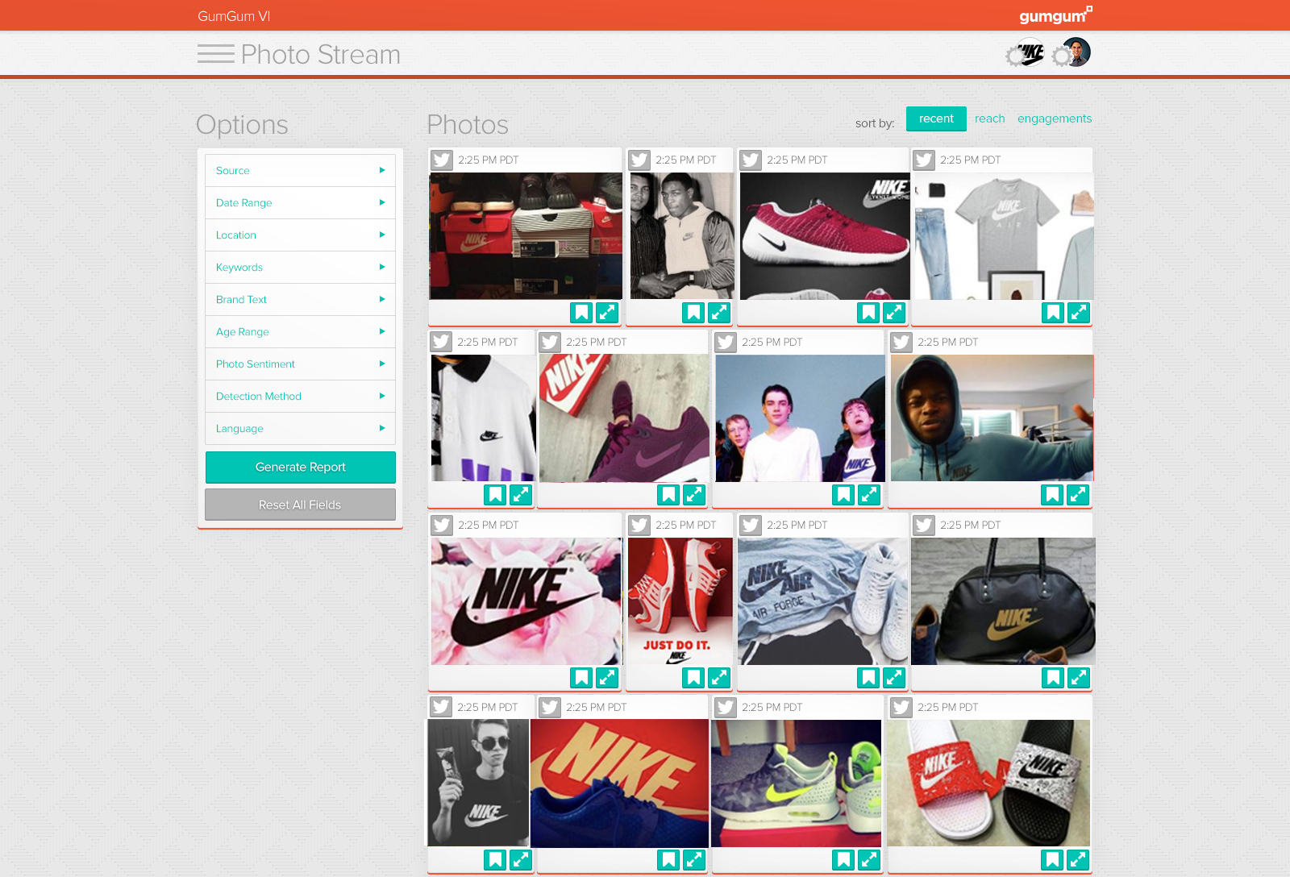

Slide 6

Lambda
Architecture
Notes:
Lambda Architecture is explained in a book written by Nathan Marz. Nathan Marz created the Storm Framework for stream processing. He created it as part of a company ‘Backtype’ which was later acquired by Twitter.

Slide 7
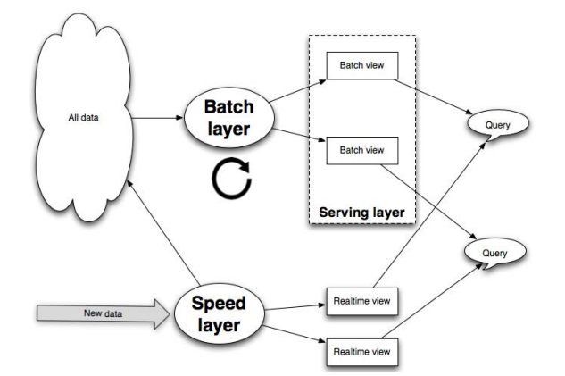
Lambda Architecture
Notes:
Explain Lambda Architecture here - explain main points - divide and conquer - divide your data processing in batch layer and speed layer. Batch layer will create daily (or hourly) views and speed layer will create views for the period. Combining both of them you can get the up to the minute picture. The reason it's’ called lambda is because batch and realtime data gets combined into one view eventually. Important concept is that real time data gets replaced by batch data because state of the realtime technologies is not completely reliable yet. This situation might be changing very soon with the advent of new frameworks such as Flink. But currently that’s how it’s in production in many mnay many companies

Slide 8










Architecture Before Cassandra
500 Ad Servers
Notes:
Explain the architecture. Explain what each technology does and it’s function the architecture briefly. Explain that Cassandra existed in GumGum architecture for a very different purpose (Image and page metadata repository), but it was not using in Lambda Architecture in any way.

Slide 9

Caps
Geo Filter
Keyword Filter
Other Filters
Cap Filter
Sort by revenue and pick one
Notes:
Ad server is nothing but a funnel. You get a request from a page to display an Ad. There are thousands of Ads configured in our database that are running. But each ad has various constraints set. For example run Toyota dealers of Souther california Ad only in Southern California. Or run Donald Trump Ad in Battleground states etc. They can be also targeted on the contents such as run Loreal Blond Hair dye ad on a person with blond hair (real example). So the job of ad server is to disqualify various ads

Slide 10


Real Time Pipeline - The Problem
500 Ad Servers
Notes:
Here zoom up real time leg of the lambda architecture and show how data was going back to the Ad Server. Explain why this data is critical for Ad Server. It was so critical that an Ad Server would stop serving ads if one of the ad server was not able to get real time data.

Slide 11

The Problem
6 mins
roundtrip time
Notes:
Significance of 6 mins here - 500 ad servers can serve millions of Ads in 6 mins. Usually our campaign used to over serve by thousands. On each campaign it wasn’t a big deal, but in aggregate it was a big deal. Plus It was in a way making publishers unhappy. If we don’t get paid for an ad serving, we cannot pay our publishers. So it was our duty towards them to minimize their loss.

Slide 12

Enter Cassandra - Phase 1
500 Ad Servers
Cassandra: US East - 21 Nodes, US West: 18 Nodes, EU West: 12 Nodes - r3.2xlarge

Slide 13
Caps
Geo Filter
Other Filters
Old Cap Filter
Cassandra Cap Filter
Sort by revenue and pick one

Slide 14
The Solution
6 mins
10 ms
Notes:
Overage - how many more ads got serve than intended? - The numbers before were 5000, 6000, 10,000. Now the numbers were 5, 10, 3, 2, 1, 0!

Slide 15
Enter Cassandra - Phase 2
500 Ad Servers
Load data every 8 mins async way
Cassandra: US East - 21 Nodes, US West: 18 Nodes, EU West: 12 Nodes - r3.2xlarge

Slide 16
Caps
Geo Filter
Other Filters
Cassandra Batch Data Filter
Cassandra Realtime
Cap Filter
Sort by revenue and pick one

Slide 17


Slide 18
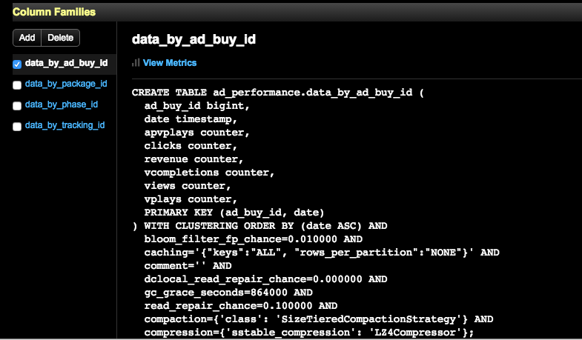

Slide 19
Scale
21 + 18 + 12 + 9 = 60 r3.2xlarge instances (Metadata)
9 + 6 + 3 = 18 r3.2xlarge instances (Tally)
400,000 records loaded every 8 mins by each Ad Server
20,000 read requests per second
10,000 write requests per second

Slide 20
Lambda Architecture
Batch Layer
Batch Views
Speed Layer
Realtime View

Slide 21
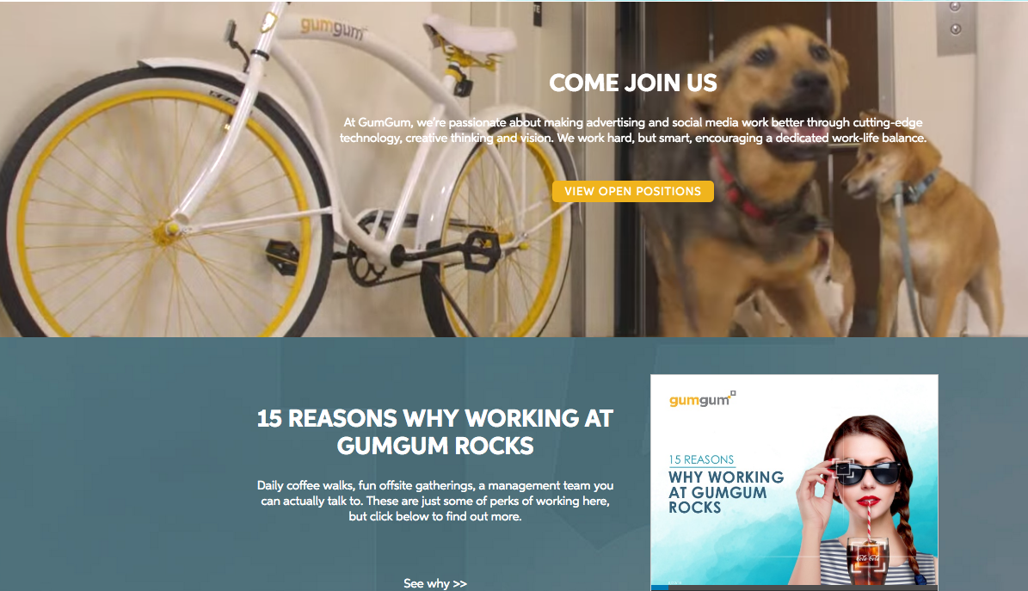
gumgum.com/careers

